Slide 1
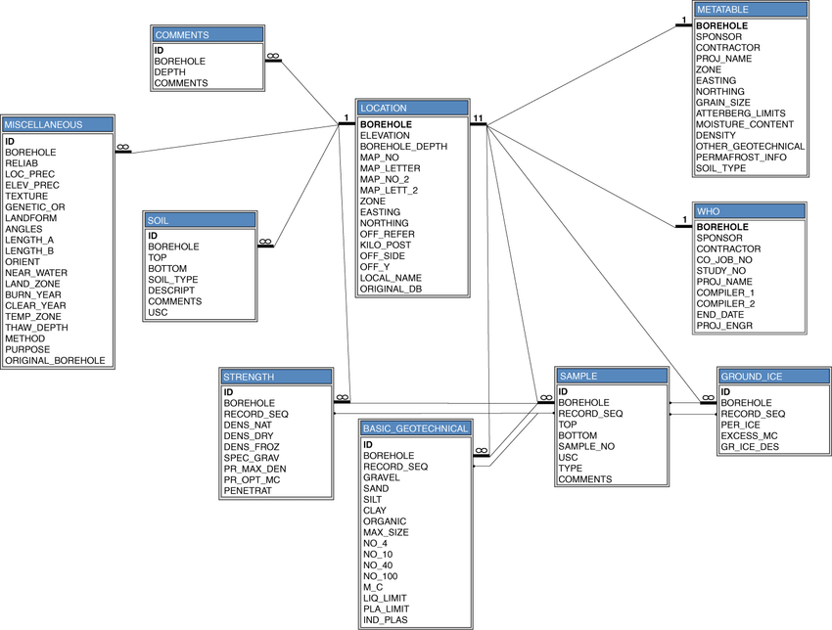
Applied Computing Slideshows by Mark Kelly vcedata.com mark@vcedata.com
Databases:
Structure,
naming,
data types,
data formats
”It’s more exciting than it sounds” – David Attenborough
“I couldn’t put it down. You had me hooked with Hungarian Notation”
- Quentin Tarantino
Version: 2024-08-20 @ 11;41;00

Slide 2


This slideshow is sponsored by Big Database Corp ™ ©
Hi, lads!
Are you constantly rejected by good-looking people at parties?
Try talking about DATABASE STRUCTURES and NAMING SCHEMES.
You can thank me later.

Slide 3

OVERVIEW
capabilities and limitations of DBMS
structure of databases
naming conventions
flat file and relational databases;
data types and data formats;
Big Database Corp ™ © says:
Databases are exciting, like THIS >>>
Believe Big Database Corp ™ ©

Slide 4
Terms to know
Table
Fields
Records
Field types – including Boolean
Validation
  range, type, existence, existence in limited list

Slide 5
Terms to know
Limited list, value list
Access hierarchy
Scripting, macros
Calculated/computed fields
Hungarian fieldname notation
  E.g. G_Total (global field), frmWages (form)

Slide 6

Concepts to know
Normalisation
Design tools
  Entity Relationship Diagram
  Data Dictionary
  Data structure diagram/chart
Big Database Corp ™ © reminds you:
Databases are exciting
Believe Big Database Corp ™ © or there will be consequences.

Slide 7

Terms to Know
Key field, primary key, match field
Foreign key
Relational
Flat-file
Relationships
  1:1
  1:many
  many:many

Slide 8

For Filemaker Pro students
Examiners should not use “Microsoft Access” terminology in exam questions – but play it safe. Know these…
Form (input) = layout
Query = find
Report (output) = layout

Slide 9
Structure of databases
Databases need at least one table of data (relational databases need at least two tables)
Each table consists of fields (columns) e.g. surname, postcode, pay rate
Each field needs to be defined before data is entered (e.g. its data type, whether it is mandatory or option, its length)
Each field has a type, e.g. Text, number, Boolean.

Slide 10
Structure of databases
A row in a table containing a full set of fields about a person or item is a record (e.g. Fred’s surname, postcode, pay rate)
Related tables are linked by relationships to allow lookups of data from other tables.
E.g. using a customer ID entered in the sales table can extract their name, address, payment history etc from the customer table.

Slide 11
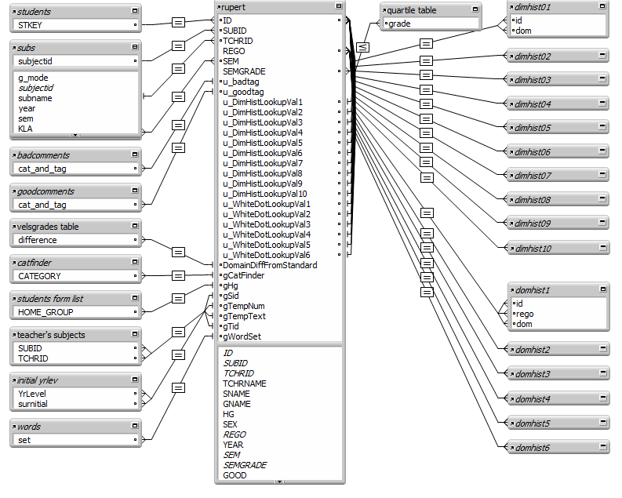
Relationships can be complicated

Slide 12

Naming conventions
Use a consistent style when naming fields, tables etc.
Avoids confusion
  E.g. global fields (one value per table instead of one value per record) can cause incorrect results if treated as an ordinary field.
  If named g_FieldName, its nature is obvious

Slide 13
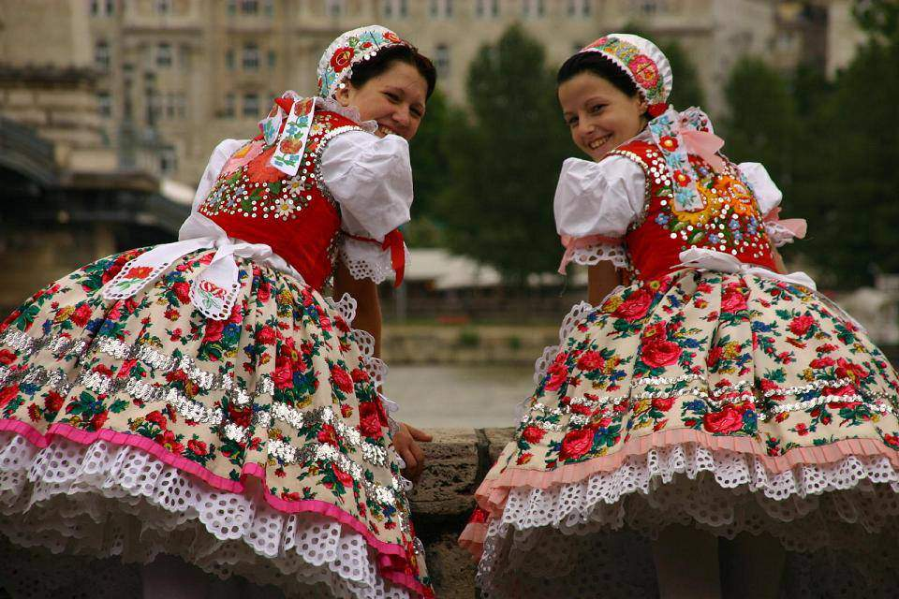
Naming conventions
Hungarian Notation: field names, variables etc are preceded by a type descriptor. E.g.
  tblStaff = table of staff
  numAbsences = numeric field
  qryUnderPaid = stored query
  rptLetters = stored report
  frmNewCustomer = input form

Slide 14
Naming Conventions
Never use spaces in fieldnames!
  Use Underlining (underscoring)
  and/or
  CamelCase – Using capitals to start words (e.g. AccountNumber)
Make fieldnames self-descriptive, not obscure (e.g. CAN = customer account number)
  Prevents errors by referring to the wrong field!

Slide 15
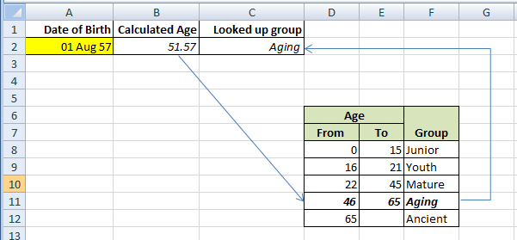
Flat file and relational databases
Flat file databases have one table (like an Excel worksheet)
Relational databases have 2 or more related tables (like an Excel VLOOKUP)
VLOOKUP actually defines a relationship between the key value Calculated Age and a matching value in the Age lookup table.

Slide 16

Why relational?
Reduces data redundancy (unnecessary repetition)
Normalisation = dividing a flat file database into related tables

Slide 17
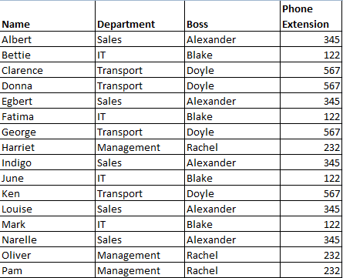
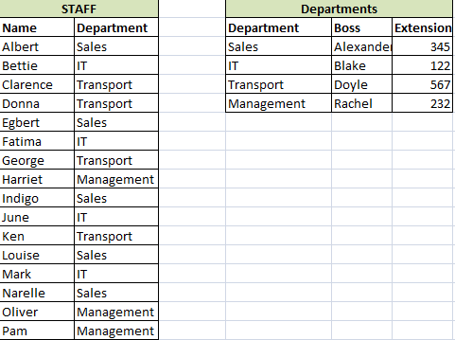
Before normalisation: flat file
After normalisation: relational
Department data is only stored once. So:
Less storage required
Department changes now only made once,
not once for each worker in the dept!

Slide 18
To find a worker’s extension:
- get their department from the STAFF table
- use the relationship between the tables to find the same department in the DEPARTMENTS table
- Read across to the field you want to fetch

Slide 19
The department field in the staff table is a key field
Used to look up matching data in the other table.
In the related table (DEPARTMENTS), the matching key field must be unique.
If there were 2 departments, the results of a lookup would be unreliable at best.

Slide 20
Primary & Foreign Keys
A field is a primary key when it appears in the table where it is defined.
A key field appearing in a table other than the one that defines it is called a foreign key.
An example is easier to understand…

Slide 21
STAFF_TABLE
Name
Department
DEPARTMENTS_TABLE
Department
Boss
Extension
The Department field is defined in the departments table, so in that table it is a primary key.
The same field appears in the staff table, but it is not defined there – it’s just referred to there. So in the staff table, Department is a foreign key.

Slide 22
Data types and data formats
Data types specify the type of data that can be stored in a field. Typically:
Text (anything that can be typed)
Number (some DBMS support types such as byte, integer, floating point etc)
Date/Time (allows time and date calculations)
Boolean (yes/no, true/false)
Container (In Filemaker, can hold any type of data e.g. photos, music, entire documents

Slide 23
Calculated fields (Filemaker)
Data is not typed in. DBMS calculates the field’s contents using a formula (which is very like an Excel formula). E.g.
  Field 1 (number): Amount_Due
  Field 2 (number): Amount_Paid
  Field 3 (calculated):
  Amount_Owing = Amount_Due - Amount_Paid

Slide 24

Calculated fields (Access)
A new field defined in a query with a formula calculates new information based on existing data.

Slide 25
Calculated fields
(u_hint_valuesVCE) * (subs::weights/100)
Note the :: which means “the related field called weights in the subs table”
In the previous employee example, the department boss’ name could be fetched with a reference to departments::boss

Slide 26
Tips
Never save people’s names in a single field
  Can’t search or sort by either first name or surname
Store phone numbers as text, not number
  Can’t use spaces, (parentheses), leading zero, dash, etc
Store suburbs & postcodes in fields separate to the address
  Allows sorting/searching by those fields
Choose the most efficient field type
  E.g. use integer, not floating point, if fractions are not needed

Slide 27
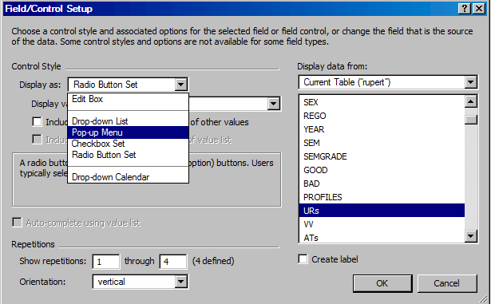
Data formats
Not to be confused with data types, which describe the contents of a field
Data formats specify how data is displayed
  E.g. date format: 10 June 2009 or 10/06/2009
  The number of decimal places to show
  Use checkboxes, radio buttons, dropdown menus, pop-up lists or text boxes?
Formatting a field in Filemaker…

Slide 28

And so soon it ends.
You were gasping for more database theory.
But, sadly, this is it for now.
This slideshow was sponsored by Big Database Corp ™ ©

Slide 29
Applied Computing Slideshows
by Mark Kelly
vcedata.com
mark@vcedata.com
These slideshows may be freely used, modified or distributed by teachers and students anywhere on the planet (but not elsewhere).
They may NOT be sold.
They must NOT be redistributed if you modify them.

