Slide 1
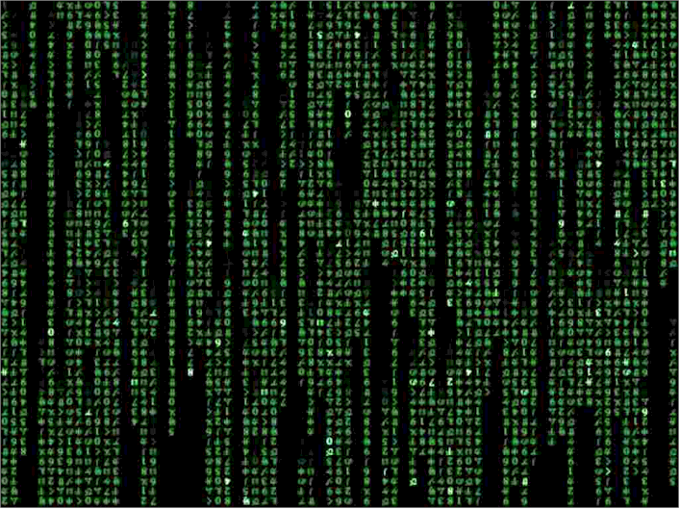
Applied Computing Slideshows by Mark Kelly vcedata.com mark@vcedata.com
Database purposes

Slide 2
What are databases?
A database is an organised collection of data (e.g. details of your CD collection)
DBMS (Database Management System) is software that creates and manages databases. E.g. Access, Filemaker, SQL.
Let’s use their names carefully, OK?

Slide 3
What do databases do?
Store data
Search data
Sort, group, calculate data
Report on data

Slide 4
Capabilities of DBMS
Capable of handling immense quantities of data of many types, including pictures etc.
Can search, sort, reorganise very quickly
Can combine related data from separate files
Can import & export data in many formats, e.g. CSV and exchange data with other apps.

Slide 5
Capabilities of DBMS
Can produce quality individualised output such as bills, certificates, letters etc.
Can be programmed to perform powerful data manipulation.
Can calculate new information from existing data (e.g. age from date of birth)

Slide 6
Limitations of DBMS
Database must be defined before data can be entered
Relationships and macro/script programming can be difficult to design
Get slower as they get bigger
Data loss can be catastrophic if there are no backups
Can be very bulky to store & transfer

Slide 7
Purposes
Databases are used to store and manage large quantities of information such as…
Recording transactions
  Bank deposits, withdrawals, credit card use
  Transaction Processing System (TPS) recording sales
Summarising bulk data
  Management Information Systems
  Executive information Systems

Slide 8
Purposes
Chronologies
  Calendars
  Diaries
  Work Logs

Slide 9
Purposes
Mass mailings
  Cheques
  Gas bills etc
  Renewal notices
  Membership notifications
  Cards, labels (e.g. cross country)

Slide 10
Purposes
Personnel records
  A school’s student records
  A company’s staff records
  School attendance
  Factory work logs, to calculate wages

Slide 11
Purposes
Network management
  Network & internet login names, passwords, privileges, restrictions
  Printing credit
  Internet credit

Slide 12
Porpoises
Storing knowledge
  KnowledgeBases
  FAQs
  Expert Systems
  Wikis

Slide 13

Purposes
Event information
    Automated system error log
    Help desk requests
    Medications issued to patients
Reports
    School reports
    Financial summaries
    Monthly bank statements

Slide 14
Purposes
Booking systems
  Airlines
  Theatre tickets
  Doctors’ appointments
  Restaurant bookings

Slide 15
Puppies
Inventories
  How many size 26 blue socks are left in stock?
  Is it time to reorder left-handed rubber flange grommets?
  Software registers
  Online shopping with real-time stock availability (e.g. Amazon)
  Library catalogues

Slide 16
Papooses
Customer Lists
    Customer records: name, address, purchases etc
    Car buyers automatically notified of safety recalls
    Dentist, doctor, optometrist reminders about checkups being due
    Library loans

Slide 17
Purposes
Government records
  Medicare payments
  Tax records
  Car registrations, driver licences
  Births, deaths and marriages
  Criminal records
  Passports, immigration records
  Pharmacy prescriptions

Slide 18
Posses
Supplier lists
    Who provides your shop with green socks?
Assets
    Furniture, IT equipment, vehicles, tools etc owned by an org

Slide 19
Purposes
Event management
  School sports carnival events, competitors and results
  Competition entries, winners
Community management
  Website, web forum memberships
  Mailing lists
  Club membership lists

Slide 20
Purpoos
Financial records
  Tax records, including GST & BAS figures
  Income, costs, profit/loss
  ISP records of customer downloads
  Insurance company policy holders & expirations
  Magazine subscriptions

Slide 21
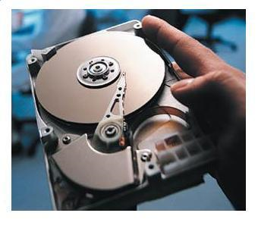
Purr pussies
Catalogues
  Libraries
  University & museum collections
  Photos (e.g. Flickr)
  Torrent trackers
  eBay items
Timetabling
  School timetables, class lists
  Public transport timetables

Slide 22
Applied Computing Slideshows by Mark Kelly vcedata.com mark@vcedata.com
These slideshows may be freely used, modified or distributed by teachers and students anywhere on the planet (but not elsewhere).
They may NOT be sold.
They must NOT be redistributed if you modify them.

