Slide 1

Applied Computing Slideshows by Mark Kelly vcedata.com mark@vcedata.com
Database Design Tools
v1.1 - 2022-02-18

Slide 2
Contents
Input-Process-Output (IPO) charts
Data tables
Structure Charts
ERD - now has its own slideshow
Data dictionaries also have their own show
Other design tools can be found in other slideshows:
  DFD, website, software development design tools

Slide 3


Slide 4
IPO chart
Used to design formulae for calculated fields
Also commonly used for spreadsheets and programming.
Components (in order of thinking):
  Output – the information required
  Input – the data required to get the information
  Processing – the algorithm (calculation strategy) that will convert the input into the output.

Slide 5
IPO chart
Input | Process | Output

Slide 6
IPO chart
Work backwards
Start by deciding what information you want
For example, someone’s age in years
Input | Process | Output
 |  | Age in years

Slide 7
IPO chart
Now work out what data (input) you need to calculate this information (output).
Need 2 pieces of data – the current date and the person’s date of birth.
Input | Process | Output
Current date Date of birth |  | Age in years

Slide 8
IPO chart
Now the tricky bit. How will the output be calculated?
The strategy used is also called an algorithm.
In the IPO chart it can be expressed in an informal but understandable fashion called pseudocode (see the separate slideshow).

Slide 9

IPO chart
Pseudocode describes the logic of processing.
It tells a programmer what calculation strategy to use when writing actual code.

Slide 10
The algorithm
Age = time between date of birth (DOB) and now.
The current date would not be typed into the database! (Why?)
A database or programming language can fetch current date from the system clock, e.g. a function like GET(Currentdate)

Slide 11
The algorithm
In Excel, Filemaker, Access etc, subtracting one date from another gives the number of days between the dates
Note: only works if the dates are saved in a date field, or as type date so the software can do the calculations!

Slide 12
The algorithm
To convert days to years, divide by 365.25
(Why the .25?)

Slide 13
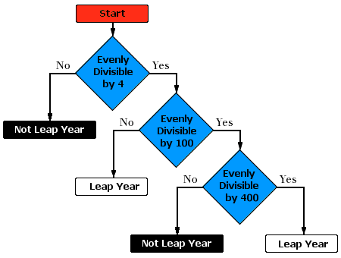
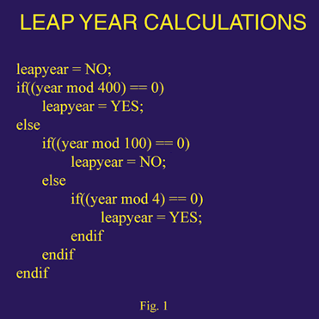
Speaking of leap years and algorithms…
Two ways of representing an algorithm:
decision tree (using flow chart symbols),
pseudocode

Slide 14
IPO chart
Now work out what data (input) you need to calculate this information (output).
Need 2 pieces of data – current date and date of birth.
Input | Process | Output
Current date Date of birth | (Now – DOB)/365.25 | Age in years

Slide 15
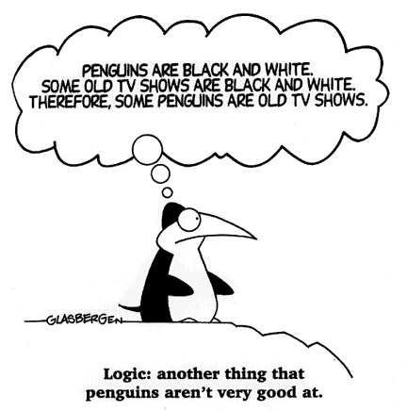
An IPO chart
Should describe the logic of every calculation in the database, spreadsheet or software being developed.

Slide 16
Data structure table / diagram
A data structure table is like a data dictionary
A table that summarises the fields in a table, including the fields’:
  Names
  Data types
  Size (if relevant)
  Validation rules
  Other useful information on each field

Slide 17
Data structure table
Field Name | Type | Length (if relevant) | Validation rule
Givenname | Text | 15 | Must exist
DOB | Date | - | Must be between 1 Jan 1908 and 31 Dec 2008
State | Text | 3 | Must exist in list: Vic, NSW, Qld, SA, WA, Tas, ACT
ID | Text | 5 | Must be unique; must be 3 uppercase letters + 2 digits; must exist.

Slide 18
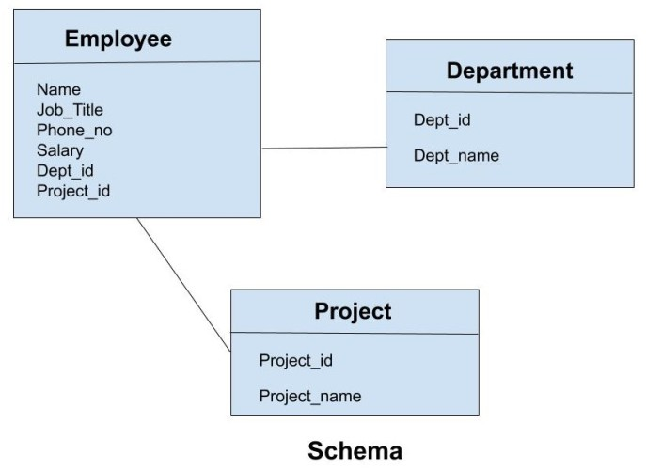
Data structure charts
May be known as a data structure diagram.
Is a visual map of how the tables in a database are how they are related
Often called a schema in database talk

Slide 19
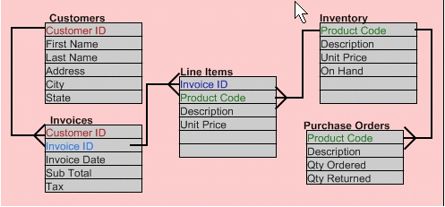
Data structure chart -
Like an ERD

Slide 20

Also
See the separate slideshow on
Entity Relationship Diagrams (ERD)

Slide 21

Because you’ve been good

Slide 22
Applied Computing Slideshows
by Mark Kelly
vcedata.com
mark@vcedata.com
These slideshows may be freely used, modified or distributed by teachers and students anywhere on the planet (but not elsewhere).
They may NOT be sold.
They must NOT be redistributed if you modify them.

