Slide 1

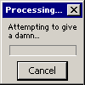
Applied Computing Slideshows by Mark Kelly vcedata.com mark@vcedata.com
Yep – another exciting theory lesson coming up!

Slide 2
Criterion? Criteria?
You have one criterion…
You have two or more criteria.
Like one cow and two cows.
One computer, two computers.

Slide 3
Evaluating...
Effectiveness = quality of output, accuracy, attractiveness, number of errors etc. How well it achieves its goals.
Efficiency = saving time, money and labour.

Slide 4
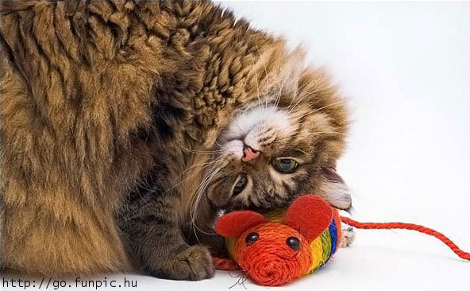
Evaluation Criteria
The features you use to judge the quality of something.
E.g. To evaluate a cat, its criteria may be:
  Furriness
  Friendliness
  Mousing ability
  Its ability to tell
  the difference
  between your
  shoes and its
  litter tray.

Slide 5
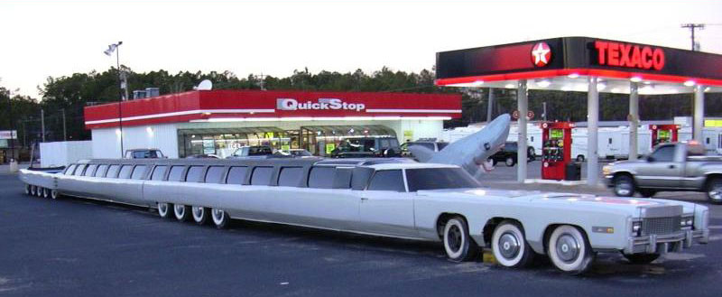
And
A car’s evaluation criteria may be:
  Safety
  Fuel consumption
  Comfort
  Acceleration
  Seating capacity

Slide 6
And
A young lady’s criteria for evaluating her new husband may be:
  Sense of humour
  Income level
  Kindness
  Ability to kill spiders in the bath
And – of course….

Slide 7

Sheer good looks

Slide 8
But
Choose criteria that are relevant and important to the thing being evaluated.
Don’t evaluate a cat on its seating capacity and acceleration.
Don’t evaluate a car on its furriness and mousing ability.

Slide 9
Choosing Criteria
When evaluating any IT product, focus on the criteria that were laid down during the analysis phase of the creation of the product.
During analysis the logical design of the product is formulated.
The logical design lays out the specifications of the finished product: what it should be able to achieve (it does not say how it will be achieved)

Slide 10
For example
When creating a gaming website, the main objectives might be:
  Should be interesting to teenagers
  Should be quick to load
  Should be easy to read
So, when evaluating its success, these are the main factors you would want to evaluate rather than (say) how much it costs to set up.

Slide 11
Typical website effectiveness evaluation criteria
Accuracy of information
Currency (being up-to-date)
Loading speed
Popularity

Slide 12
Typical website evaluation criteria
Authority (how reputable and respected it is)
Comprehensiveness (thorough coverage of topic)
Depth of coverage
Profitability (costs vs income generation)

Slide 13
Typical website evaluation criteria
Reliability (links work, site is not often down etc)
Security (especially if storing customers’ passwords, credit card info etc)
Uniqueness (offering things found nowhere else)
Objectivity (unbiased in matters of ‘fact’)

Slide 14
Typical website evaluation criteria
Ease of locating desired information
Attractiveness
“Hipness” – looking cool, dope, awesome, alvo, grouse, amped, bad, beautimus , cherry, chim, choice, clutch, crump, etc
Ease of understanding

Slide 15
Typical website evaluation criteria
Accessibility (to people with disabilities)
Entertainment value
Not all these criteria are relevant to - or important to – every site.
Which ones are important depends on the ambitions of the site owners.

Slide 16
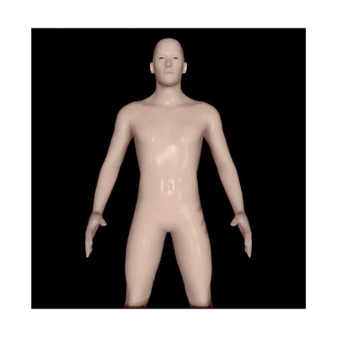
Efficiency criteria
How quickly a page loads, a page prints etc
How many man-hours are needed to get the job done
How much the system costs to buy, run, maintain etc
How quickly a page loads, a page prints etc
How many man-hours are needed to get the job done
How much the system costs to buy, run, maintain etc
And this is a random picture because this theory stuff has been getting rather dull recently.

Slide 17

Evaluation methods
To evaluate a criterion, you need a corresponding evaluation method or strategy.
Objectively measure whenever possible; rely on subjective opinions when measurement is not possible.

Slide 18
Criterion | Strategy
Loading speed | Clear cache, load site, use stopwatch to measure loading time in seconds.
Authority | Look up its Google rating
Accuracy | Count the number of complaints received about inaccurate data
Currency | Count the number of page updates made per week

Slide 19
Criterion | Strategy
Entertainment factor | Survey users about how entertaining they found the site to be
Ease of use | Conduct a questionnaire asking users to report their opinion
Reliability | Study web server’s error log for 404 (page not found) errors etc.
Profitability | Study economic records to compare site costs vs online sales .

Slide 20
Evaluation methods
interviewing users about their opinions of the system
examining error logs to determine the reliability of the system
timing its speed when carrying out a typical process
load-testing the system to quantify its performance under pressure
study its output to judge its readability, accuracy, attractiveness
survey customers about the ease of use of the system
refer to security logs to see if the system has been subject to successful hacking attempts
create error conditions (e.g. pull the plug out) and see if test data is lost or damaged, and how well the system recovers from power outage
compare output from the new system with output from the old system and see if it is better
Read the log of complaints by users or customers

Slide 21
Remember
Evaluation comes at the very end of a project
Is not the same as testing.
Testing should already have proved the product works.
Evaluation determines how successful the project has been.
Learn lessons to make the next project even more successful e.g…

Slide 22
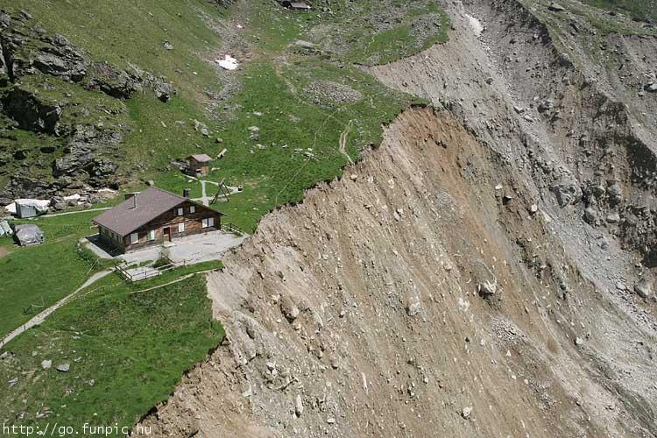
Next time, we don’t build quite so close to a cliff

Slide 23

Applied Computing Slideshows
by Mark Kelly
vcedata.com
mark@vcedata.com
These slideshows may be freely used, modified or distributed by teachers and students anywhere on this planet (but not elsewhere).
They may NOT be sold.
They must NOT be redistributed if you modify them.
Do not feed them to cats.

