Slide 1
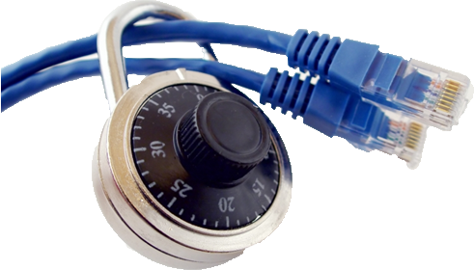
Applied Computing Slideshows by Mark Kelly vcedata.com mark@vcedata.com
Data Security

Slide 2
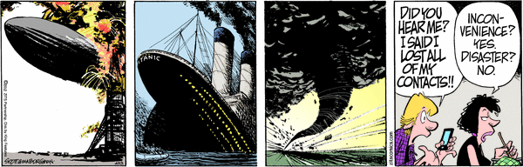
Contents
Physical and software controls for protecting stored and communicated data.
‘Zits’

Slide 3
Data Security
Virtual teams often work with confidential or secret data
All data needs to be protected against loss or damage
Sensitive information needs protection against theft

Slide 4
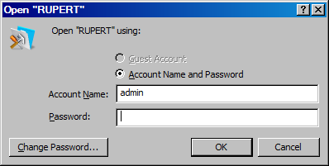
SOFTWARE - Passwords
Passwords can be applied to:
  Individual computers
  Network access
  Website access
  FTP access
  Opening documents
  Changing documents
A password-protected database

Slide 5
SOFTWARE + HARDWARE - Biometric ID
Passwords are weak protection
Easily forgotten, discovered, guessed
Biometric ID measures a unique physical attribute of an individual, e.g.
  Fingerprint
  Iris pattern (the coloured bit of the eye)
  Retinal pattern (the blood vessels at the back of the eye)
Can’t be copied, faked, stolen as passwords and swipe cards can

Slide 6
SOFTWARE - Encryption
Makes stored files unreadable for unauthorised people
Public Key encryption does not have an unlocking key - the weak point of all previous encryption systems
Public key encryption (look up RSA, PGP) is very, VERY hard to break
Even if an encrypted document is stolen or copied, it is worthless to the thief

Slide 7
Encryption during communication
SSL (Secure Socket Layer) and TLS (Transport Layer Security) encrypt web traffic
Is active when the padlock in your browser snaps shut
Messages between web servers (e.g. banks) and visitors are encrypted by the sender and decrypted by the recipient
Secure sites sometimes identifiable by a HTTPS:// prefix

Slide 8
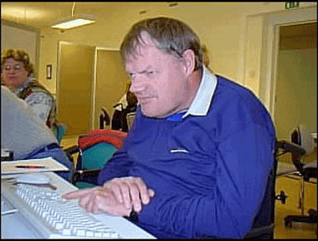
SOFTWARE - Access hierarchy
Different users get different levels of access to data
Level of access based on what they need to get their work done
Prevents unskilled, stupid or
evil people deliberately,
carelessly or accidentally
destroying data

Slide 9
Access hierarchy
Databases, for example, can assign rights such as:
  See some data, but not all
  See all data, but not add/delete/change change it
  Add data but not delete any
  Add and delete data but not change any programming or presentation layouts
  Access all areas

Slide 10
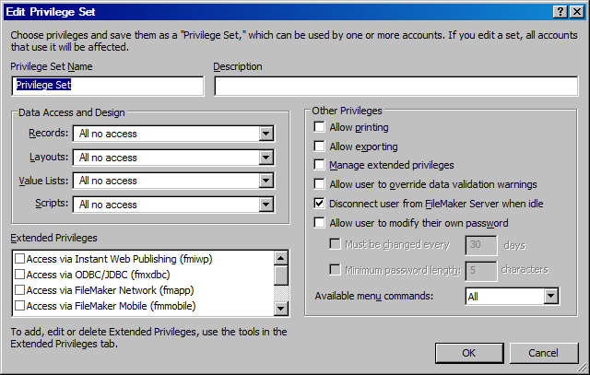
Access Privileges in Filemaker

Slide 11
Safe Disposal
‘Deleted’ files are easily recovered
To be safe, unwanted files should be wiped
Military-grade wiping involves overwriting data at least 7 times with rubbish data
Computers being disposed of should have their hard disks reformatted.
But reformatting can be reversed!
Some organisers shred used hard disks to be sure. The disks are physically pulverised.

Slide 12
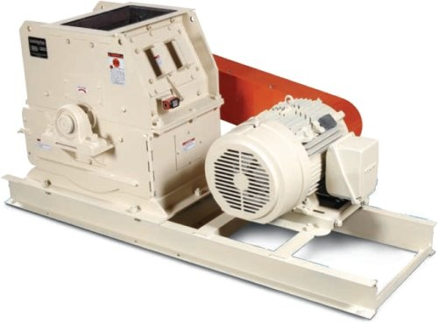
Hard disk destruction
Hours of crushing fun…
http://www.youtube.com/watch?v=sQYPCPB1g3o
http://www.youtube.com/watch?v=8qImGK8bHjE

Slide 13
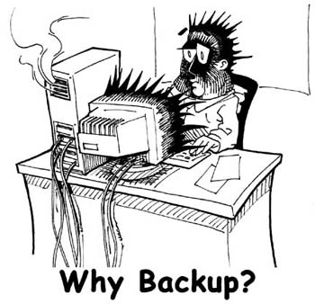
Backups
Backup = copying data so it can be restored if the original is lost or damaged
Must be done regularly (daily!)
Must be stored offsite
Procedure must be tested
and documented

Slide 14
Backup types
Full = copy absolutely everything: new and old data and programs
Incremental (partial, differential) = copy only files that are new or have been changed since the last backup.

Slide 15
Typical Scheme
Weekly full backups
Daily incremental backups
To restore data, reload the latest full backup and then add on all the incremental backups made since then.
Backups are increasingly being done continuously to the cloud.

Slide 16
Continuous Data Protection (CDP)
Changed files are automatically saved to local or remote storage
Different versions of the same-named file can be restored
Can save to cloud, local network, or remtoe friend’s computer
E.g. CRASHPLAN.COM

Slide 17
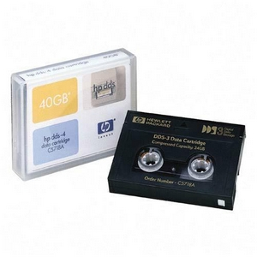
Backup Media
“Media” = what the data is saved to
Tape = large capacity, slow, wears out, expensive. Very common
Removable hard disk = fast, large capacity, cheap.
CD/DVD = relatively low capacity, easily damaged. Non-magnetic, so not hurt by electromagnetic fields as are tapes, HDDs.

Slide 18
Backup Media
Selection criteria:
  Read/write speed
  Capacity
  Lifetime of recorded data
  Robustness (e.g. against scratching, magnetic fields)

Slide 19
Archiving
Copy obsolete data to secondary storage (e.g. DVD) and delete the original data.
Backing up = copy data, keep the original.

Slide 20
Virus scanners
Must have up-to-date virus definitions
Must be running all the time
Must be accurate:
  false-positives – wrongly believes a virus exists
  false-negatives – fails to identify a virus
Even market-leading products are imperfect
Some free products (e.g. Avira) outperformed Symantec & McAfee in a test in 2009.

Slide 21
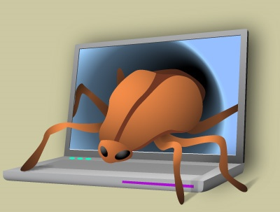
Other scanners
Malware – spyware, adware. Either does bad things (e.g. monitoring users’ actions) or is badly programmed and badly affects the stability of computers.

Slide 22
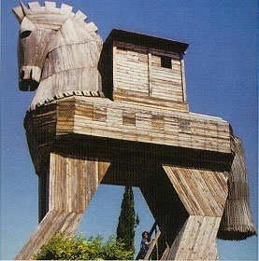
Other scanners
Trojan Horses – bad software installed by users who think it’s innocent. Payloads:
  Keylogger: records passwords, credit card info, bank account logins & sends them to hackers.
  Spamming agent: your computer acts as a zombie sending spam on behalf of the hacker
  Distributed Denial Of Service (DDOS)
  attack: your computer is taken over
  and joins a concerted attack on a
  server chosen by the hacker.

Slide 23
Firewalls
Closes unused internet communication ports
Your computer has 65535 of them, but you only use about 3.
Hackers can gain entry to a PC through unguarded ports
Firewalls close the unused ports
Open ports are watched to ensure only authorised programs use them (preventing Trojans sending spam or DDOS attacks)

Slide 24
Software Firewalls
Can be software or hardware firewalls
Software: Windows Firewall, Zone Alarm
Needs training when first installed. You teach it which programs are allowed to connect to the internet

Slide 25
Hardware firewalls
Routers – on all Local Area Networks, and in nearly all home/office cable/ADSL modems
Can use Stateful Packet Inspection (SPI) to examine inside data packets to see if they’re harmful.
Protect against incoming bad data, but not outgoing bad data. If you’re already infected by a Trojan, a router won’t stop your PC sending spam, keylogs etc

Slide 26
Other physical controls
Locked doors
Barred windows
UPS (uninterruptible power supply) to protect file servers or workstations from power overloads, blackouts
Air conditioning to protect hardware from humidity, heat.
Swipe cards to control physical user access

Slide 27
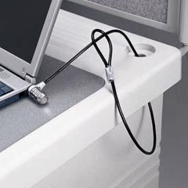
More physical controls
‘Kensington cable’ discourages thieves walking off with items.
Quality door locks
Window locks

Slide 28
Consequences of not protecting data

Slide 29
Consequences
loss of trade secrets
potential violation of the Privacy Act, Health Records Act etc if personal information is damaged or released
loss of reputation as a trustworthy organisation
loss of income after catastrophic data loss destroys your ability to get paid by customers or conduct business
prosecution by the tax office if tax records are lost
corporate death

Slide 30
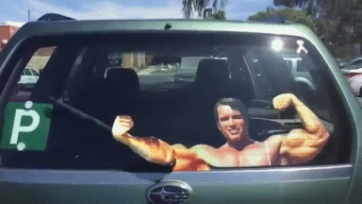
And because you’ve been good…

Slide 31
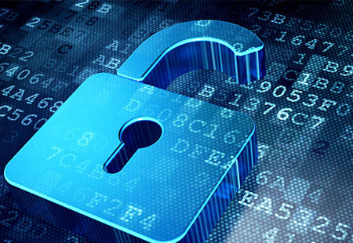
Applied Computing Slideshows by Mark Kelly vcedata.com mark@vcedata.com
These slideshows may be freely used, modified or distributed by teachers and students anywhere on the planet (but not elsewhere).
They may NOT be sold.
They must NOT be redistributed if you modify them.

