Slide 1

Applied Computing Slideshows by Mark Kelly vcedata.com mark@vcedata.com
dATA dICTIONARIES

Slide 2
Purpose of data dictionaries
A data dictionary is a design tool.
It summarises what data a solution will require, and the properties of the data.
It is used to
  design the structure of a program or database,
  act as a reference source during development
  be used during software maintenance and upgrade after implementation.

Slide 3
Content of a data dictionary
At a minimum:
  Data item’s name
  Data type
  Vital properties without which the object cannot be created, e.g. field length (when a length is not automatically set by the compiler or RDBMS, such as integer, date)

Slide 4
Content of a data dictionary
May also contain:
  Validation rules, particularly:
    Existence: whether the field value must be entered or whether it can be null
    Range: upper and lower limits or lengths of a value, or options in a limited list of choices
    Whether a value must be unique (e.g. CustomerID)

Slide 5
Content of a data dictionary
May also contain:
  Formatting information
  Description of the purpose of the data item
  Sample data
  In a RDBMS, whether the field is a primary key.
  A default value, to be used if another value is not given (e.g. Country = ‘Australia’)

Slide 6
Basic example
Name | Data Type | Length
txtFamilyName | text | 25
txtGivenName | text | 15
dateDOB | date | Auto
boolMarried? | Boolean | 1
intNumPets | integer | Auto

Slide 7
More developed example
Name | Data Type | Length | Required? | Validation
txtFamilyName | text | 25 | true
txtGivenName | text | 15 | true
dateDOB | date | Auto | true | > 1/1/1940
boolMarried? | Boolean | 1 | False
intNumPets | integer | Auto | false | >=0

Slide 8
Even more detailed example
Name | Data Type | Length | Required? | Validation | Description | Sample
txtFamilyName | text | 25 | true |  | Surname | Smith
txtGivenName | text | 15 | true |  | First Name | Fred
dateDOB | date | Auto | true | > 1/1/1940 | Date of Birth | 30/12/1966
boolMarried? | Boolean | 1 | False |  | Is Married? | True
intNumPets | integer | Auto | false | >=0 | Number of pets owned | 3

Slide 9
Miscellanous notes
To avoid ambiguity, avoid calling a field ‘First Name’. In many cultures (e.g. Asia) the first name given is actually the person’s family name.
  E.g. Chef ‘Hiroyuki Sakai’ in Australia would be known as ‘Sakai Hiroyuki’ at home in Japan.

Slide 10
Miscellanous notes
A phone number field should always be defined as text to allow the use of parentheses, spaces, dashes, leading zeroes, e.g. 0402 123 456
Use the most efficient data type available, e.g. date/time types, short integer.

Slide 11
Miscellanous notes
Plan data types carefully. A number type that is currently big enough may one day be too small to hold an accurate value.
  E.g. a club uses the byte data type to store the number of members. It works well for years since club memberships don’t exceed 255 – the capacity of a byte field. One day the 256th member joins and the database chokes.

Slide 12
Miscellanous notes
Don’t make validation rules so strict that they wrongly forbid the entry of valid data, or force the entry of inaccurate data
E.g.
  making phone numbers compulsory will force people with no phone to invent a number
  requiring 4-digit postcodes may make foreign customers enter a useless or dangerous fake value

Slide 13
Miscellanous notes
When naming data items
Use Hungarian Notation (e.g. intNumPets) to identify the data type or object type in the name to prevent misusing the object (e.g. trying to store decimal fraction in an integer, or confusing a label with a text box and trying to set a property that the label does not possess)
Since spaces are hardly ever allowed in names, use CamelCase (e.g. intNumPets) to make it easier to read multi-word object names.
Note: neither Hungarian Notation nor CamelCase is named in the study design, but they are the classical ‘good naming techniques’. If asked a question about naming objects do not simply say, ’Use Hungarian Notation and CamelCase’. Describe them, perhaps with examples and explain their benefits.

Slide 14
IN REVIEW
Data dictionaries summarise data used in a database or program

Slide 15
What sort of design tool?
Can be logical data dictionary which lays down what data is required in a general sense (e.g. "What data should be in a sales contract?")
Can also be a physical data dictionary design tool e.g. in the sales contract record there is a sale_date (type date), customer_ID (text, 10 characters) etc."

Slide 16
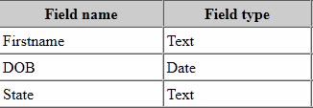
What goes in a data dictionary?
Minimal version:

Slide 17
And upwards from there…
Field name
Length (e.g. of text field)
Short description
Data type (characters, numeric, etc.), size
Null (empty) value allowed?
Default value (used if no other value given)
Allowed values; other validation rules
Whether it’s a key field
Formula used in calculated field
Other information, as desired.

Slide 18
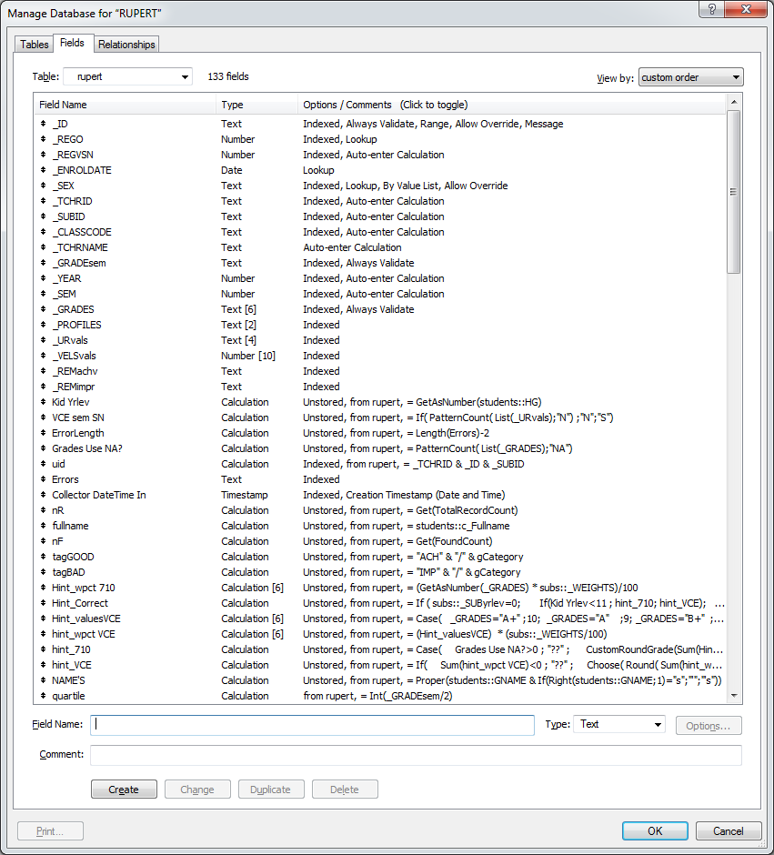
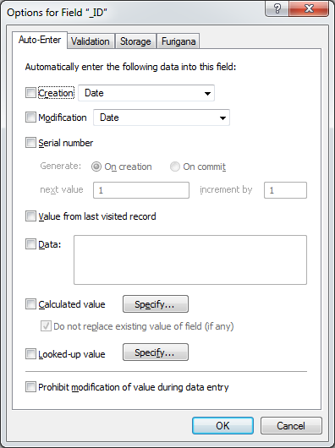
In Filemaker

Slide 19
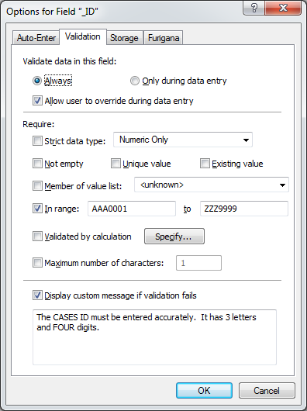
Entering Filemaker validation rules

Slide 20
Applied Computing Slideshows by Mark Kelly vcedata.com mark@vcedata.com
These slideshows may be freely used, modified or distributed by teachers and students anywhere
but
they may NOT be sold.
they must NOT be redistributed if you modify them.
This is not a VCAA publication and does not speak for VCAA.
Portions (e.g. exam questions, study design extracts, glossary terms) may be copyright Victorian Curriculum and Assessment Authority and are used with permission for educational purposes. Thanks, guys!

Slide 21
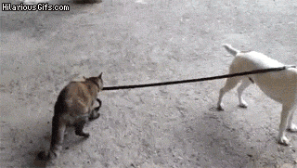
THANKS!
Because you’ve been so good, here’s a picture you can look at
while your teacher works out what to do next

