Slide 1
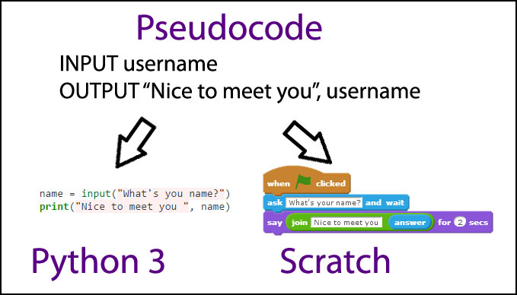
Applied Computing Slideshows by Mark Kelly vcedata.com mark@vcedata.com
Pseudocode
1

Slide 2
Contents
Purpose of pseudocode
VCAA pseudocode conventions

Slide 3
Purpose of pseudocode
Pseudocode describes an algorithm
  A strategy for calculating an answer
Rapid algorithm design
  Free-form expression, no syntax rules – lets designers focus on ideas, and not be slowed down by observing strict code and punctuation rules
Pseudocode is universal
  Not specific to any language
  Can be converted into any language’s syntax

Slide 4
Purpose of pseudocode
Clarity of meaning
  If the idea behind some pseudocode is easily understood, it is successful.
  If it’s confusing or impenetrably obscure, it fails.

Slide 5
Purpose of pseudocode
Information for organisations and teams
Good code begins with introductory basic info so an author can be contacted if necessary, and the function can be identified easily e.g…

Slide 6
Purpose of pseudocode
This was found in the code on a BBC webpage
/*!
* contentloaded.js
*
* Author: Diego Perini (diego.perini at gmail.com)
* Summary: cross-browser wrapper for DOMContentLoaded
* Updated: 20101020
* License: MIT
* Version: 1.2
*
* URL:
* http://javascript.nwbox.com/ContentLoaded/
* http://javascript.nwbox.com/ContentLoaded/MIT-LICENSE
*
*/

Slide 7
Pseudocode Example
sub shuffle
create an array of 52 integers - cards(52)
loop through the array
fill each array item with the index value (1 to 52)
End loop
loop through the array
generate a random number (rnd) between 1 and 52
swap the value of the current slot with that of array(rnd)
end loop
end sub

Slide 8
Binary search algorithm - example pseudocode
// two slashes indicate a comment
// Finds the location or non-existence of value X in a data set of N items.
Sort data set items in ascending order.
Set StartPoint = 1
Set EndPoint = N
Set Exists to True
Set Found to False
While not Found and Exists = True
Calculate data set’s middle item’s position … (Endpoint-Startpoint)/2.
Store middle item’s position as MidPos.
Get value of item at MidPos and store it as MidValue.
If X=M then // We have found X.
Set Found to True
Else If X > M // throw away first half of the dataset
set Startpoint to MidPos + 1
Else if X < M // throw away second half of dataset
set EndPoint to MidPos – 1
End if
If MidValue = 0 then set Exists to False
End While
If Exists = False then display “Item X not found” else display “Item X found at position M”

Slide 9
Purpose of pseudocode
The binary sort example shows typical pseudocode features.
  Expression is a loose mixture of English and code
  May not be 100% consistent, but makes sense
  Does not dwell on finicky details that are not vitally important to the task in hand (e.g. how to sort the dataset)

Slide 10
Purpose of pseudocode
The binary sort example shows typical pseudocode features.
  Describes an approach to solving the problem without getting bogged down in details.
  Code indentation to emphasise logical structure and flow

Slide 11
Purpose of pseudocode
The binary sort example shows typical pseudocode features.
  Arbitrary but consistent conventions (e.g. // to indicate comments)
  Internal documentation (comments) to explain the workings of the algorithm
  Meaningful object names (e.g. StartPoint)

Slide 12
VCAA pseudocode conventions
While pseudocode famously has no syntax rules…
(and cannot suffer from syntax errors, so you won’t find an exam question asking about syntax errors in pseudocode!) …
VCAA has a few long-standing conventions for its pseudocode in exams.

Slide 13
VCAA pseudocode conventions
1. The = symbol is only used for logical testing, e.g. if A=3 then do something
2. The ← symbol is used for assignment,
e.g. If A=3 then B ← N
Read it as “If A is equal to 3, then set the value of B to the value of N”

Slide 14
VCAA pseudocode conventions
3. Code indentation is always used to show lines of code are controlled by
selection structures (e.g. IF, THEN, ELSE, ELSE IF) or
iteration structures (e.g. WHILE, FOR loops)

Slide 15
VCAA pseudocode conventions
4. Keywords may be arbitrary, but they are consistent.
e.g. if GET means ‘read from a file’ and INPUT means ‘read from the keyboard’ the two terms always mean the same thing in a piece of pseudocode.

Slide 16
VCAA pseudocode conventions
Tip – use comments to explain the meaning of keywords that may be misinterpreted.
e.g.
$ The dollar sign precedes a comment.
$ PRINT = output to a printer.
$ DISPLAY = show onscreen.
$ WRITE = save to a data file on disk.

Slide 17
VCAA pseudocode conventions
5. Blocks of pseudocode usually start with BEGIN and finish with END.

Slide 18
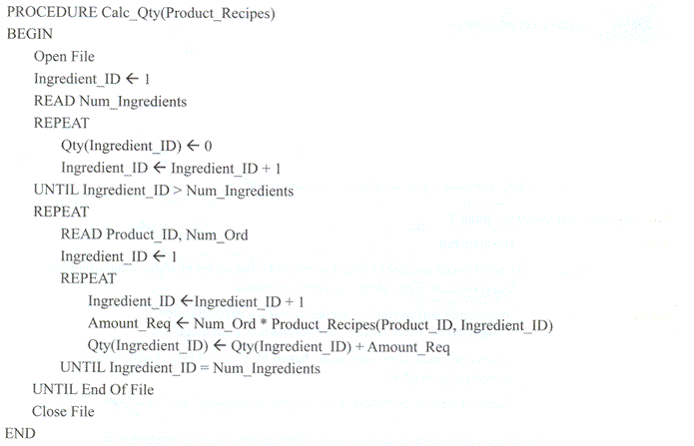
Typical Exam Pseudocode

Slide 19
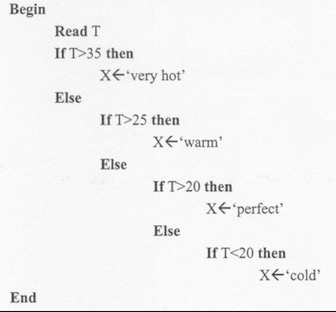
Exam Pseudocode

Slide 20
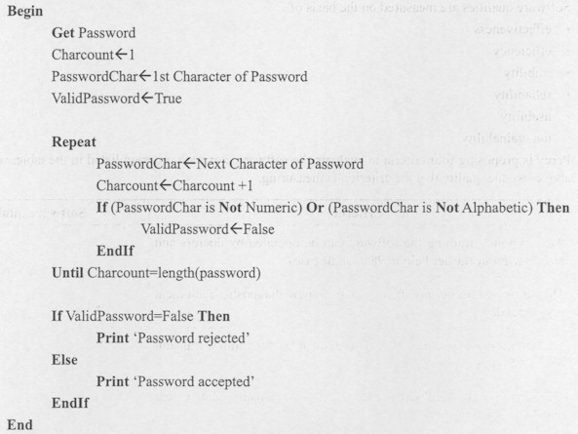
Exam Pseudocode

Slide 21
Examining Pseudocode
How pseudocode is usually examined by VCAA
What is the intended output of this pseudocode?
What is the actual output of this pseudocode?
What line or lines of code cause the actual output to differ from the intended output?

Slide 22
Examining Pseudocode
How pseudocode is usually examined by VCAA
What changes should be made to the pseudocode to fix the error?
How could this pseudocode be made more efficient?
Some of the pseudocode is missing. Write the pseudocode in the place it should appear.

Slide 23
Examining Pseudocode
How pseudocode is usually examined by VCAA
What test data would best thoroughly test the accuracy of the pseudocode?
“Developer 1 believes the pseudocode should be changed like this. Developer 2 disagrees. Which developer is correct? Justify your answer.”
How many times will the loop in this pseudocode be executed?
Name the search/sort algorithm used by this pseudocode.

Slide 24
Examining Pseudocode
How pseudocode is usually examined by VCAA
A programmer wants to create this output… Which of these four pieces of pseudocode will best attain that goal?
Identify the line(s) of pseudocode that demonstrates a selection/repetition structure.
Why has a two-dimensional array been used in this pseudocode instead of three one-dimensional arrays?
Provide better names for the storage structures named A, B and C.

Slide 25
Applied Computing Slideshows
by Mark Kelly
vcedata.com
mark@vcedata.com
These slideshows may be freely used, modified or distributed by teachers and students anywhere
but
they may NOT be sold.
they must NOT be redistributed if you modify them.
This is not a VCAA publication and does not speak for VCAA.
Portions (e.g. exam questions, study design extracts, glossary terms) may be copyright Victorian Curriculum and Assessment Authority and are used with permission for educational purposes. Thanks, guys!

Slide 26
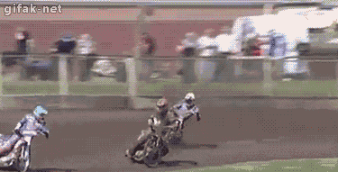
And because you’ve been so well-behaved, here’s a picture you can look at

