Slide 1
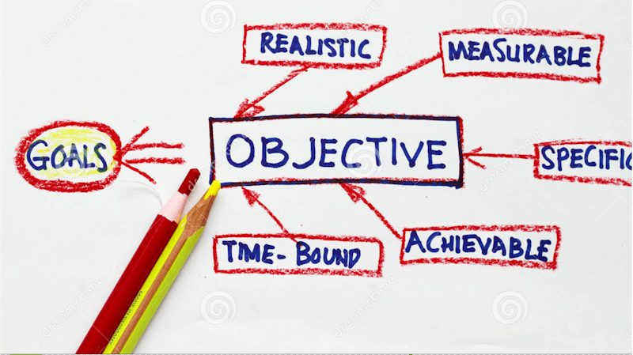
Applied Computing Slideshows by Mark Kelly vcedata.com mark@vcedata.com
Organisation and system
goals and objectives

Slide 2
Contents
Goals
Objectives
Organisational goals and objectives
System goals and objectives

Slide 3
Goals
Big, long term, rather vague targets to be achieved
Hard to measure how well – or if, or when – they have been achieved
For example “Good customer service”, “Security”

Slide 4
Objectives
Specific, measurable, achievable steps towards achieving a larger goal
Quantifiable – can be proved to be achieved or not using statistics, observation, logs.
For example, “Answering customer enquiries within 24 hours” is a good step towards achieving the goal of “Good customer service”.

Slide 5
Organisational goals
Organisations have goals that the entire organisation aims to achieve in all of its departments and operations. For example
Profit (for commercial organisations)
Good customer service
Good communications with staff and customers
Efficient work practices
Good reputation
Good decision-making practices
Protection of data
Good staff morale
Cheap, reliable products (or expensive, luxurious, top-quality products)

Slide 6
Organisational goals
Such goals often serve to define the nature of each organisation.
Compare the probable organisational goals of Rolls Royce vs Hyundai, or Ferrari vs Land Rover.
Compare the probable goals of Myers and K-Mart.

Slide 7
Organisation goals
The aims of an organisation - the things the org strives for and prides itself on.
These goals are often written down in a mission statement: a brief philosophical statement that defines what is important to the organisation.

Slide 8
Org goals
Customers often select one organisation over another based on its goals.
You can tell an organisation's genuine organisational goals when they have to make a decision

Slide 9
Org goals
If a store had to choose between raising prices or sacking staff its decision can reflect its organisational goals. If store 'A' raised prices, it implies that it values the provision of good customer service and is not willing to cut staff if it can help it.

Slide 10
Org goals
If store 'B' cut staff, you might be able to assume that the store is more concerned with keeping prices down, even if service suffers.
Org goals are a culture or attitude held by an org that shapes every decision it makes.

Slide 11
Some organisations goals are pretty easy to work out. Hospitals would, you'd hope, have excellent medical outcomes as their main organisational goals. Schools would aim primarily for providing quality education. A shop might aim for personalised and courteous service. Another shop might aim to provide the best prices.

Slide 12
Conflicts can occur when goals collide: what if a private school that valued the quality of its education had to cut costs? Would a private hospital start using second-hand scalpels to save money in tough times? It's pretty common to hear of company directors or staff resigning because they believe their company has started ignoring its primary goals.

Slide 13
Detecting org goals in a case study
When you are given a case study, you are often told what the organisation goals are. It might say, "Fred's Moving Company" prides itself on..." or "ABC Printing aims to..." or "Giraffe Restumping Co. is concerned that..."

Slide 14
Detecting org goals in a case study
These are clues to what the organisations consider important. The fact the the Giraffe Restumping Co. is "concerned" suggests that one of their valued organisational goals is being threatened.

Slide 15
Generic goals
Apart from the organisational goals given to you in a case study, there are some standard ones you can assume for any organisation:

Slide 16
Generic goals
FOR COMMERCIAL ORGANISATIONS: profit. Whatever they do, in the end, should eventually lead to increased profit. Some actions may not be immediately obvious as profitable.

Slide 17
Generic goals
Sponsoring charities, as mentioned above, may seem like throwing money away, but if it gets them publicity and "warm fuzzies" from the community, they will increase their number of customers and their competitiveness against rivals.

Slide 18
Generic goals
Spending big money on new technology may seem foolish until you realise that the expense will be recouped after a while from better productivity (producing more stuff in a given time), reduced costs or better quality products (which will attract customers away from rivals.)

Slide 19
Generic goals
FOR NOT-FOR-PROFIT / SERVICE ORGANISATIONS: service. Whatever they do, in the end, should eventually lead to providing a better service to their clients. Any profits are re-invested in the organisation.

Slide 20
FOR ANY ORGANISATION
efficiency: Every organisation wants to be efficient: they don't want to waste time, money or effort.
good decision making: Every organisation wants to make informed and wise decisions to help them achieve their organisation goals.

Slide 21
FOR ANY ORGANISATION
effectiveness. Every organisation wants to do their work well. How well they are prepared to do it, of course, will be affected by organisational goals.
  The manager of a company making the dinky little toys in K-Mart Christmas Crackers is probably not going to lie awake at night worrying that his plastic jewellery does not look realistic enough

Slide 22
FOR ANY ORGANISATION
The manager is more likely to value cost over quality.
On the other hand, the designer of an anti-missile system is not likely to try to get much business by offering countries a cut-price missile defence shield that only intercepts 50% of incoming nuclear missiles.

Slide 23
FOR ANY ORGANISATION
good reputation: no organisation aims to look stupid or incompetent
  (well, it seems some must but I don't think they really aim to do it).

Slide 24
FOR ANY ORGANISATION
Every organisation wants to be regarded as competent in whatever they do, whether it is quality, price, speed or any other factor.
Companies will often go to extreme lengths to build or hold on to a reputation because their reputation is their biggest asset.
  Research “good will” as a factor in the price of a company being sold.
If, in a store that prided itself on customer service, a sales assistant insulted a customer you could expect the management to be horrified and bend over backwards to make amends. If "Pronto Printing" were renowned for its accuracy and quick results and its production suddenly got late and sloppy, you'd expect the management to very quickly find the causes of the problems and eliminate them.

Slide 25
FOR ANY ORGANISATION
Good customer service: one hopes most organisations would value this

Slide 26
System Goals and Objectives
Within each organisation there are information systems.
Information systems have specific system goals.
The systems exist to do a particular job, and their success can be measured by specific criteria.

Slide 27
System goal examples
a payroll system's goal may be to produce accurate pay cheques, keep efficient track of tax deductions, and produce very readable summarised statements for management and government departments.

Slide 28
System goal examples
a desktop publishing system's goal may be to produce high quality page layouts for magazine-quality printing.

Slide 29
System goal examples
a point-of-sale transaction processing system's goal may be to accurately and quickly record purchases, produce customer receipts, and update stock inventories after each sale.

Slide 30
System goal examples
Note the difference between system goals and organisational goals. An organisation will contain many different systems.

Slide 31
System goals are what each system in that organisation is aiming to achieve.

Slide 32
Organisational goals should be supported by the systems in the organisation. For example if an organisational goal is "efficiency", each system in the organisation would also need to have its own efficiency goals.

Slide 33
A company priding itself on good communications would be sure to have a goals of "fast, easy to use, high capacity" etc for its email system.

Slide 34
Common system goals
speed
accuracy
reliability
quality of output
capacity
security
ease of use

Slide 35
Common system goals
cost effectiveness
attractiveness of appearance
flexibility
configurability (is there such a word?)
expandabilit
safety (noone wants to be sued)

Slide 36
Common system goals
operator comfort
durability
robustness, strength, toughness, endurance
compatibility with other systems

Slide 37
If you're still confused
Think of your house as an organisation: its organisational goal is to keep you safe, healthy, comfortable and entertained.
In the house there are many systems: the doors; the beds and chairs; the TV, radio, computer, medicine cabinet; and bookshelves.

Slide 38
If you're still confused
The security system (e.g. doors, locks) have their system goals: to prevent unauthorised entry of burglars, to keep out insects and wild animals, to keep out rain and wind.

Slide 39
If you're still confused
The furniture system has their own system goals: to provide comfortable support.
The entertainment system's goals are to provide entertainment such as Bob the Builder, cricket commentaries and fine story telling.

Slide 40
If you're still confused
You would not, however, expect a toaster to entertain you (unless you're weird) because that is not one of its system goals. Nor would you expect a bed to entertain you... hang on, I may have to think about that one.

Slide 41
OBJECTIVES
System Goals and Objectives - small, specific, measurable, achievable steps towards achieving a larger goal.
They can definitely be seen to have been achieved or not (unlike goals, which are too vague and big to be conclusively "achieved" or not)

Slide 42
IDENTIFYING OBJECTIVES
Objectives are quite precise. If it contains an exact target (e.g. a 5% increase in output) it's an objective, not a goal.
Well-defined time scales – for example, “Within six months…”
Defined economic parameters (limits) for example “Spending no more than $500,000 we want to…”
Tip – objectives often contain specific numeric targets.

Slide 43
OBJECTIVES
e.g. A system goal of a desktop publishing system may be “To produce attractive output.”
The corresponding objectives may be:
To print at a minumum resolution of 600 dots per inch.
To handle colour and monochrome photographic images.
To offer at least 100 typefaces.
<number>

Slide 44
Applied Computing Slideshows by Mark Kelly vcedata.com mark@vcedata.com
These slideshows may be freely used, modified or distributed by teachers and students anywhere
but
they may NOT be sold.
they must NOT be redistributed if you modify them.
This is not a VCAA publication and does not speak for VCAA.
Portions (e.g. exam questions, study design extracts, glossary terms) may be copyright Victorian Curriculum and Assessment Authority and are used with permission for educational purposes. Thanks, guys!

Slide 45
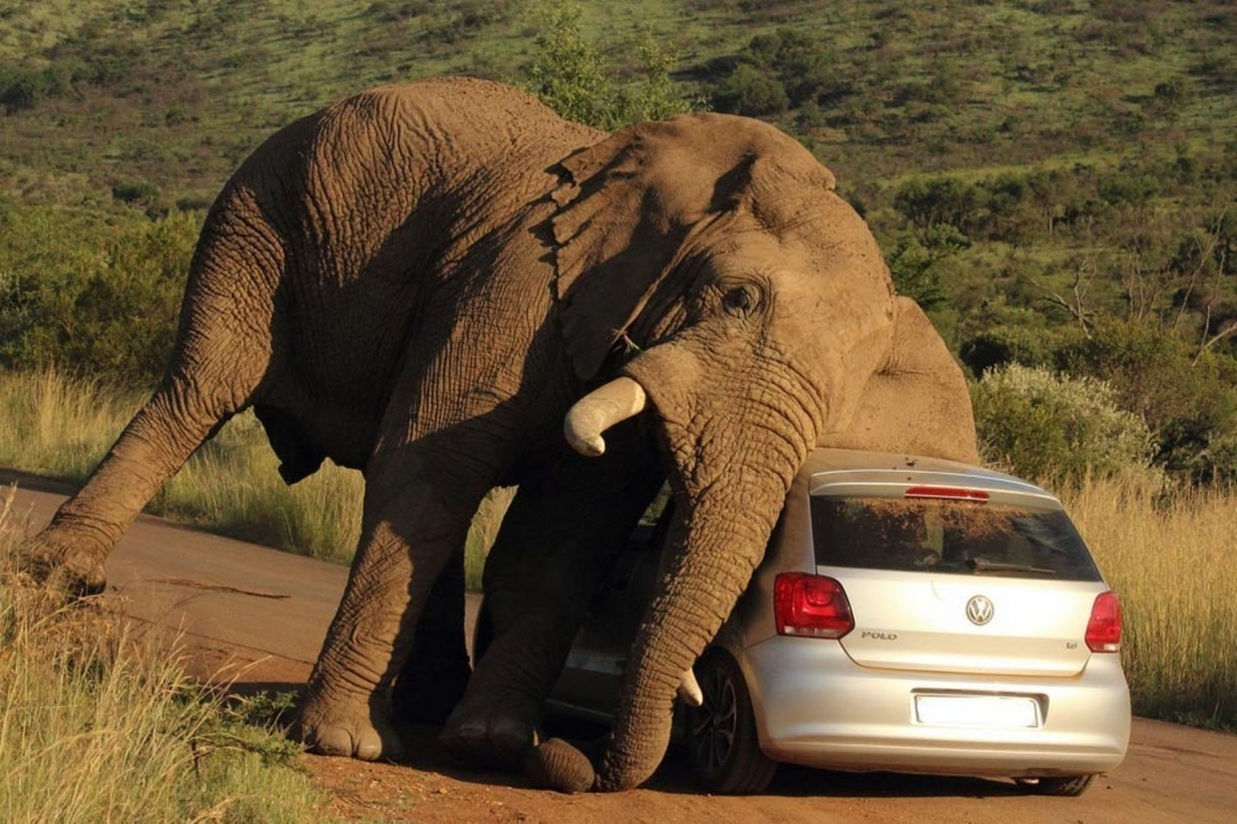
THANKS!
Because you’ve been so good, here’s a picture you can look at
while your teacher works out what to do next

