Slide 1
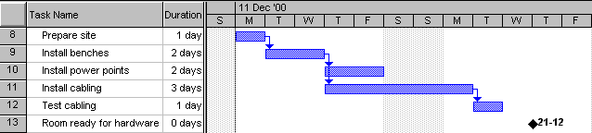
Having Fun with
Gantt
Applied Computing Slideshows
by Mark Kelly
vcedata.com
mark@vcedata.com

Slide 2
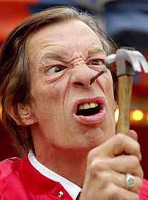
Well, “fun” might be optimistic
At least they’re more fun than this…

Slide 3
What is Gantt?
Gantt charts :
are timelines
manage the tasks involved in big and complex projects
let project managers organise time, people, equipment and money
ensure the right people and equipment are in the right place and the right time

Slide 4
What is Gantt?
Gantt charts :
allow managers to monitor the progress of a project
are adjusted to reflect actual project progress

Slide 5
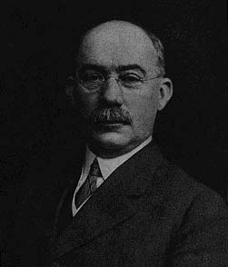
Gantt
Charts
Gantt
Charts
Henry Laurence Gantt (1861-1919)

Slide 6
Gantt
Charts
Gantt
Charts
Henry Laurence Gantt (1861-1919)
And please spell my name right.
It’s Gantt.
Not ‘Gannt’.
Not GANTT.

Slide 7
Gantt
Charts
Gantt
Charts
Henry Laurence Gantt (1861-1919)
Thanks.
And did you know that Gantt charts are a huge hit at parties?

Slide 8
Gantt
Charts
Gantt
Charts
Henry Laurence Gantt (1861-1919)
Call me.

Slide 9
How much do you need to know?
The study design requires you to have a basic understanding of project management concepts.
You need to be able to create and modify a simple Gantt chart with software.
You do not have to know anything about PERT charts (another common project management tool)

Slide 10
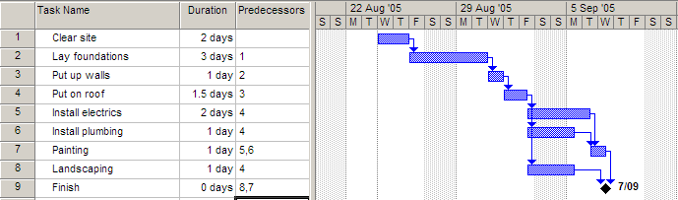
Gantt Basics
Basically, a timeline with tasks that can be connected to each other

Slide 11
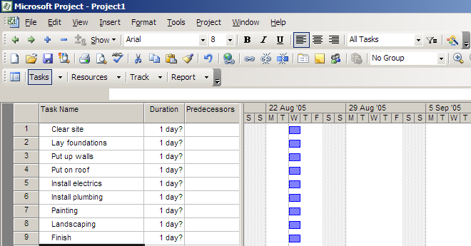
Making a Gantt chart
Step 1 – list all of the tasks in the project

Slide 12
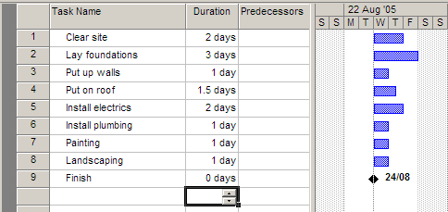
Making a Gantt chart
Step 2 – add task durations.

Slide 13
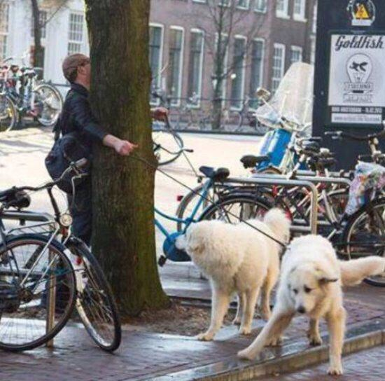
Making a Gantt chart
Skill and industry-experience guide the choice of task durations.
But real-world events usually mess with predicted durations…

Slide 14
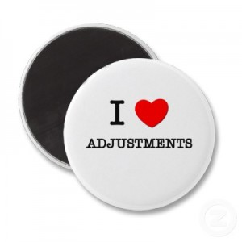
Making a Gantt chart
Charts must be adjusted to reflect real-world progress.
Your SAC must contain evidence of such adjustments.

Slide 15
Making a Gantt chart
Using the right software makes chart adjustments easy.
More on software choices later…

Slide 16
Making a Gantt chart
Step 3 – add dependencies (the tasks that cannot start before another task finishes)

Slide 17
Dependencies
The arrows indicate dependencies.
Task 1 is a predecessor of task 2 – i.e. task 2 cannot start before task 1 ends.
Task 3 is dependent on task 2. Task 7 is dependent on two other tasks
Electrics, plumbing and landscaping are concurrent tasks and can happen at the same time, so they overlap on the chart. All 3 can start after task 4 ends.
Painting must wait for both electrics and plumbing to be finished.
Task 9 has zero duration, and is a milestone

Slide 18
Scope in 2016-2019
You need to know the terms dependency and milestone.
The term predecessor is handy to know, but probably won’t appear on the exam.
Know the terms critical path and slack time, just in case.

Slide 19
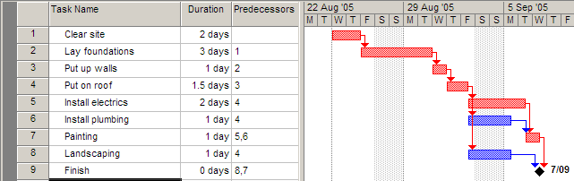
Slack is the amount of time a task can run overtime before it affects other tasks.
Task 6 can take an extra day and a half before it affects the project’s end date, so each has 1.5 day’s slack.
If a task runs overtime and it has no slack, the start dates of following tasks will be affected.

Slide 20
The diamond shape indicates a milestone.
Used to monitor whether a project is on schedule or not. E.g. “The enter project must be finished by 9 September.”
A milestone is an event, not a task – a point of major progress in the project. It has ZERO duration.
i.e. nothing must be done to achieve it – it just HAPPENS because of previous stuff happening.

Slide 21
Milestones
Milestones are events, not tasks – they happen, but no time or work is required to accomplish them.
They are points of major progress in the project.
They usually refer to the start or end of major tasks or groups of tasks.
The end-date is the major milestone of any project.
Milestones are created as tasks with zero duration and no resources (e.g. staffing).

Slide 22
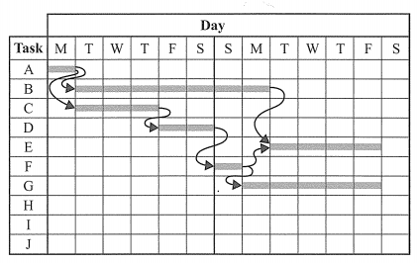
Real Exam Questions
Informatics 2016 – A11
For the Gantt chart shown above, a delay in the completion of Task D by one day will
a. have no effect on Task E.
b. delay only Task E by one day.
c. delay only Task F by one day.
d. delay both tasks E and F by one day.

Slide 23
Real Exam Questions
Informatics 2016 – A11
For the Gantt chart shown above, a delay in the completion of Task D by one day will
a. have no effect on Task E.
b. delay only Task E by one day.
c. delay only Task F by one day.
d. delay both tasks E and F by one day.
Answer is A. Why?

Slide 24
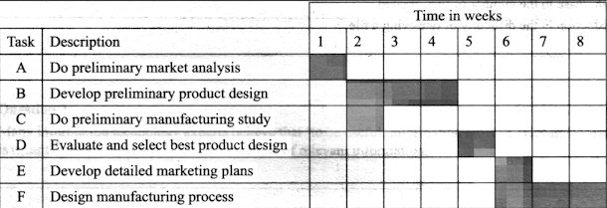
2003 Exam Multichoice Q16
Is Task D is a predecessor for :
(A) Tasks E & F?
(B) Tasks B & C?
(C) Tasks C & F?
(D) Tasks B & E?

Slide 25
2003 Exam Multichoice Q16
No dependency arrows – be prepared for this in exam questions.
Assume that any task that does not start on day 1 must be dependent on some other task.
Which tasks are dependent on task D?
Find the tasks that start as soon as task D has finished… E and F. So the answer is [A].

Slide 26
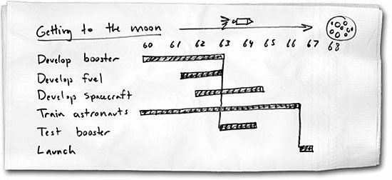
Gantt tools
Study design says that Gantt charts (‘project plans’) must be created with software. Not hand-drawn!

Slide 27
Gantt tools
Excel is possible but NOT recommended.
  Dependency arrows are nearly impossible.
  Updating charts is a major pain because tasks are not logically connected. Changing one task means manually adjusting several others.
← Yuk!

Slide 28
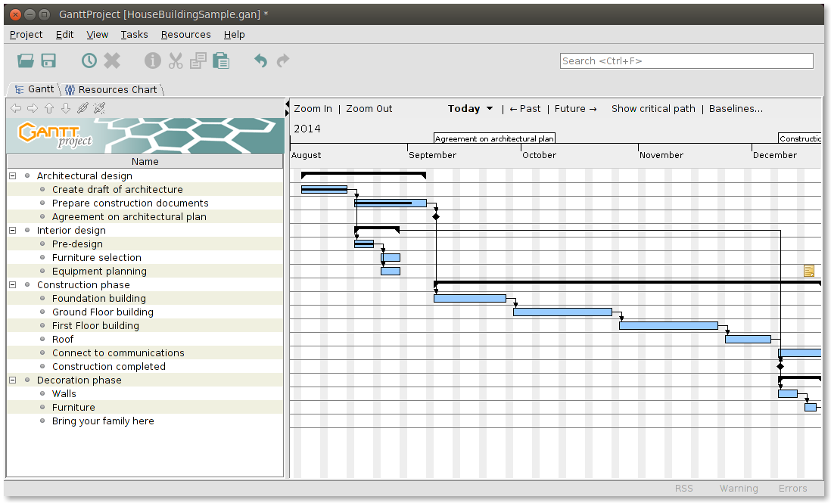
GanttProject (free) at ganttproject.biz
(still working in 2024)
    A nice, simple tool. Lacks a few fancy features (e.g. allowing different working hours for different tasks) but will suit all VCE needs.

Slide 29
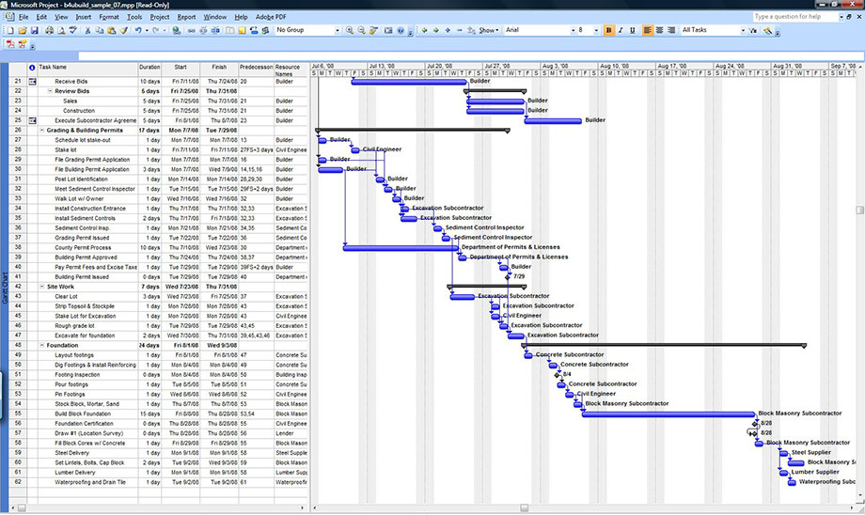
  Microsoft Project.
    Big, fully-featured, $$$

Slide 30
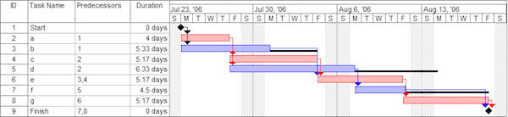
Online Gantt creators
  Dozens of sites exist, e.g. Ganttpro.com, smartsheet.com
  Many are free.
  Problem: charts are not portable, and must be saved and edited on the site.
  Need internet access.
← smartsheet.com

Slide 31
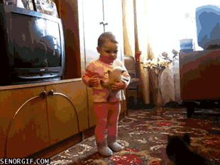
Because you’ve been good

Slide 32
Thanks
Applied Computing Slideshows
by Mark Kelly
vcedata.com
mark@vcedata.com

