Slide 1
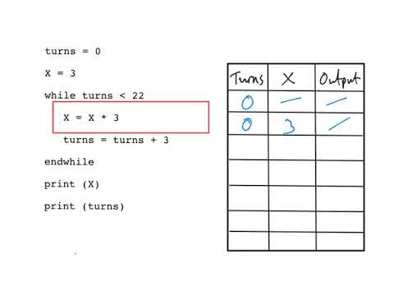
Applied Computing Slideshows by Mark Kelly vcedata.com mark@vcedata.com
TESTING
Trace Tables, Desk Checks

Slide 2
Contents
Trace Tables
Desk Checks

Slide 3
Trace Tables
Related to, but are not identical to desk checks.
A method of testing the behaviour of algorithms in pseudocode.
Step-by-step manual calculation of the current values of variables to ensure the actual output agrees with the expected output.

Slide 4
Trace Tables
Trace tables provide a formal method for tracing the logic of an algorithm.
Test data is chosen to test all paths within the algorithm.
All variables, constants and formal parameter values need to be represented.

Slide 5
Trace Tables
Module DisplayLargestNumber
1 Largest ← 0
2 Input (Number)
3 Repeat
4 If Number > Largest then
5 Largest ← Number
6 End If
7 Input (Number)
8 Until (Number = 999)
9 Output (‘The largest number is ‘, Largest)
End Module

Slide 6
Trace Tables
Test data values are [2, 3, 6, 5, 7, 999].
In the trace table that follows, numbers at the start of lines represent line numbers of pseudocode

Slide 7
Trace Tables
Line | Largest | Num | Num > Largest? | Num = 999? | Output
1 | 0
2 |  | 2
4 |  |  | T
5 | 2
7 |  | 3
8 |  |  |  | F
4 |  |  | T
5 | 3
7 |  | 6
8 |  |  |  | F
4 |  |  | T
5 | 6
7 |  | 5
8 |  |  |  | F
4 |  |  | F
7 |  | 7
8 |  |  |  | F
4 |  |  | T
5 | 7
7 |  | 999
8 |  |  |  | T
9 |  |  |  |  | MAX=7
1 Largest ← 0
2 Input (Num)
3 Repeat
4 If Num > Largest then
5 Largest ← Num
6 End If
7 Input (Num)
8 Until (Num = 999)
9 Output (‘MAX= ‘, Largest)
Notes:
- T=True, F=False.
- This variety is called the “expanded method”.
- I used yellow highlighting to emphasise the iterations of the REPEAT loop.

Slide 8
Trace Tables
Note – this only works if you FASTIDIOUSLY and EXACTLY follow EVERY line of the pseudocode like a human compiler.
It is very useful for classical exam questions of the type:
  Here is some pseudocode.
  What is the expected output?
  What is the actual output?
  Where in the code is the error?
  How would you fix the error?”

Slide 9
Desk Checks
Similar to trace tables in that every line of pseudocode is traced manually to determine current variable values and correct program flow.

Slide 10
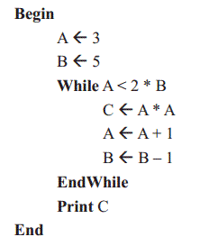
Desk Checks
From the 2015 SD Exam, question A3
Question 3
What is the output from the pseudocode?
A. 4
B. 9
C. 16
D. 25

Slide 11
Desk Checks
Like a trace table, every line is stepped through manually to calculate exactly what a compiler would calculate.
Attention to detail is critical!
This is how I do deskchecks.
I separate each line of code with drawn lines.
Each look of the code adds another column…

Slide 12
Desk Checks
Like a trace table, every line is stepped through manually to calculate exactly what a compiler would calculate.
Attention to detail is critical!
This is how I do deskchecks.
I separate each line of code with drawn lines.
Each look of the code adds another column…

Slide 13
Desk Checks
 | Loop 1 | Loop 2 | Loop 3
A ← 3 | a =3
B ← 5 | b=5
While A < 2*B | True! (3<5*2) | True! (4<4*2) | True! (5<3*2) | False! (6 is not < 2*2=4)
C ← A*A | c=3*3=9 | c=4*4=16 | c=5*5=25 | skip
A ← A+1 | a=3+1=4 | a=4+1=5 | a=5+1=6 | skip
B ← B-1 | b=5-1=4 | b=4-1=3 | b=3-1=2 | skip
Endwhile | loop again | loop again | loop again | skip
 |  |  |  | Print c (25)

Slide 14
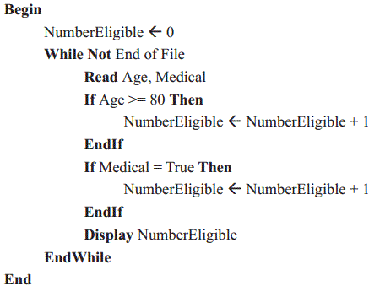
Try A Desk Check (2015 SD Exam C4)
The council wants to offer mobile voting to voters aged 80 and above or those who may be unable to get to the polling booth due to a diagnosed medical condition. To obtain an estimate of how many voters will require mobile voting, Sally has decided to use the council's electronic roll of eligible voters. She will create a file containing each voter's name, address, age and information on whether they have a diagnosed medical condition. The following algorithm is suggested, with Age being the age of the person in years and Medical indicating if they have a diagnosed medical condition.
a. To check this algorithm before coding, the data in the table (right) was created.
Complete the table by filling in both expected and actual values after each record is read and the loop is executed. 3 marks
Record number | Age | Medical | Expected value of Number Eligible | Actual value of Number Eligible
1 | 81 | False | 1 | 1
2 | 75 | True
3 | 75 | False
4 | 85 | True

Slide 15
Try A Desk Check (2015 SD Exam C4)
b. Outline the major error in this algorithm. 1 mark
c. Write new lines of code to correct this error. 2 marks
Record number | Age | Medical | Expected value of Number Eligible | Actual value of Number Eligible
1 | 81 | False | 1 | 1
2 | 75 | True
3 | 75 | False
4 | 85 | True

Slide 16
Try A Desk Check (2015 SD Exam C4)
Answers are in the vcedata.com 2015 SD Post Mortem

Slide 17
References
Computer Science Stage 2 and 3, Specifications booklet 2015, published by the School Curriculum and Standards Authority, Government of Western Australia. Page 19.
http://www.scsa.wa.edu.au/internet/_Documents/CSC_public/Computer_Science_Specifications_Booklet_pdf.pdf

Slide 18
Applied Computing Slideshows by Mark Kelly vcedata.com mark@vcedata.com
These slideshows may be freely used, modified or distributed by teachers and students anywhere
but
they may NOT be sold.
they must NOT be redistributed if you modify them.
This is not a VCAA publication and does not speak for VCAA.
Portions (e.g. exam questions, study design extracts, glossary terms) may be copyright Victorian Curriculum and Assessment Authority and are used with permission for educational purposes.

Slide 19
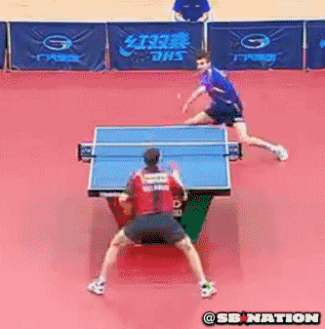
THANKS!
Because you’ve been so good, here’s a picture you can look at
while your teacher works out what to do next

